Slide 1

Data analytics career accelerator 2023 cohort 2 Course 2 Assignment: Diagnostic Analysis using Python
Student name: Rose Ryan
Submission date: 17 August 2023

Slide 2

introduction

Slide 3
Introduction
The problem to be solved
The purpose of this analysis is for the NHS to establish, for a period between 2021 and 2022:
Whether their staffing levels are correct across multiple networks and across healthcare professional (HCP) type
What was the actual utilisation of resources
The analysis aims to help inform whether staffing levels need to be raised or lowered at certain periods for future years, in order to maximize staffing provision
The process followed
Python was used for all the analysis, as it is able to handle large datasets and maintain confidentiality of data where necessary
The code notebook is hosted in GitHub which allows for code sharing and collaboration within the team and a powerful version control system, allowing a team to work together seamlessly, sharing code, tracking changes, and contributing to each others’ work

Slide 4
Importing and Exploring the data
The three data sets were imported into the environment being used for the analysis
The necessary Python libraries were also imported
After standard data checking and cleaning processes to get a ‘feel’ for the three datasets and identify any issues, analysis was performed on all three data sets independently
The data sets were explored to include:
number of locations
top five locations by number of records
number of service settings
context types
national categories
appointment statuses

Slide 5
Identifying Trends and Patterns

Slide 6

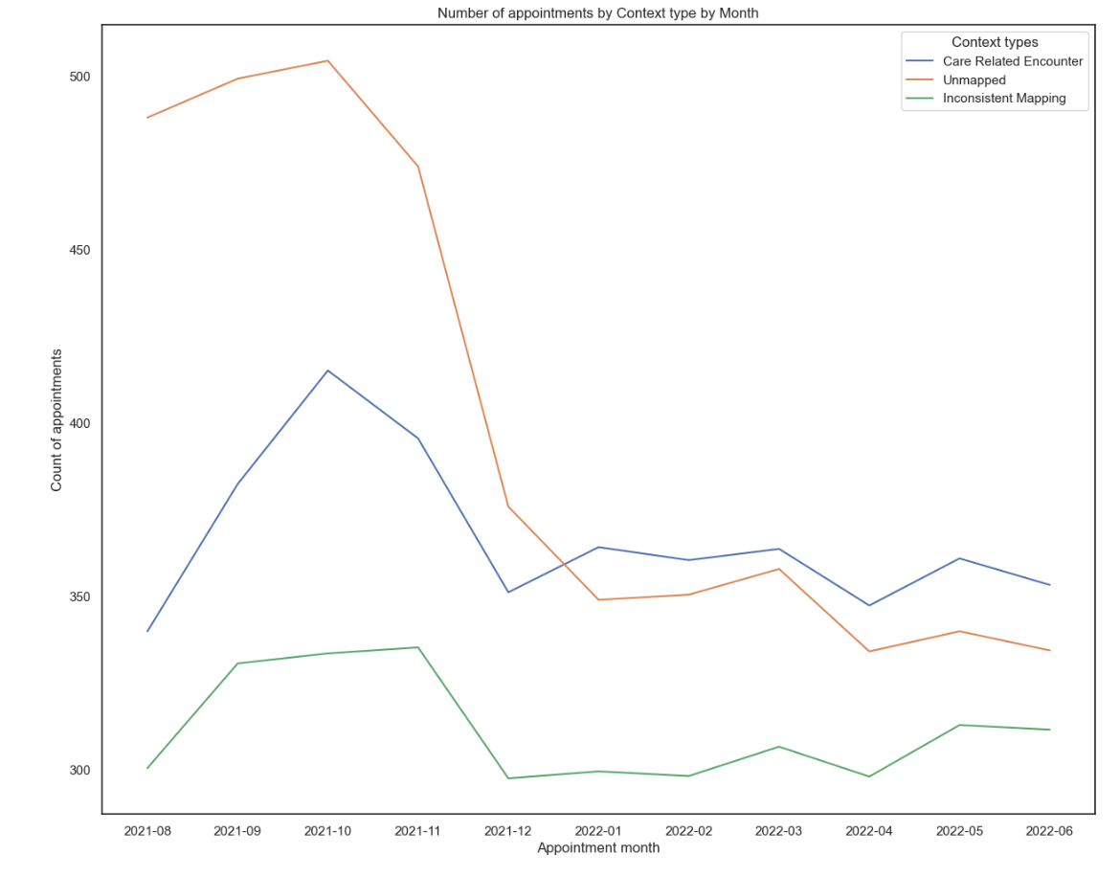
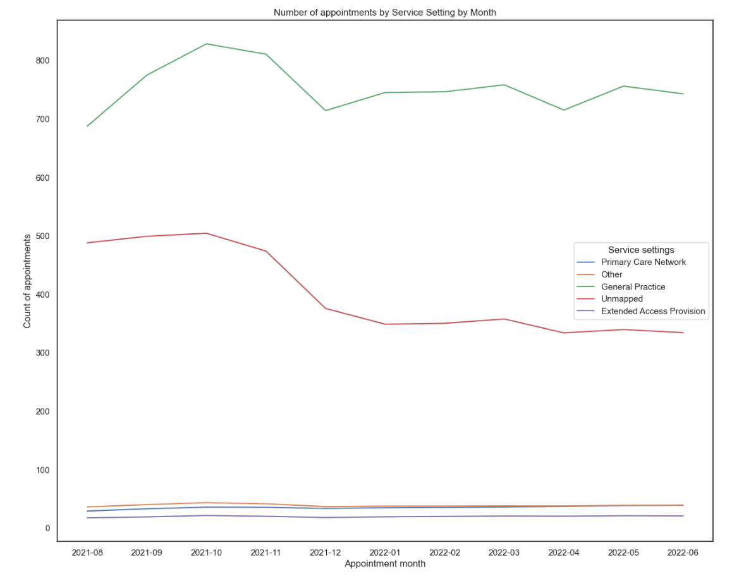
Number of appointments by service setting & context, by month (Aug 21 – June 22)
General Practice represents the highest Service Setting type
The large drop in appointments leading up to December would need to be looked at further
There are large numbers of ‘Unmapped’ appointments (the second largest context after General Practice) which would also require further analysis

Slide 7
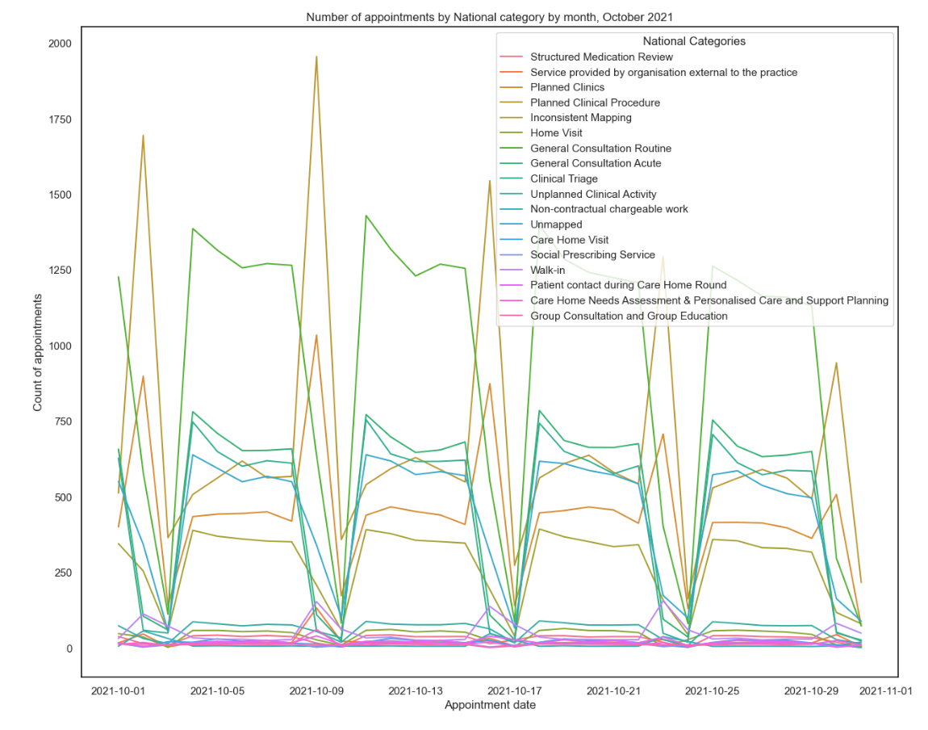
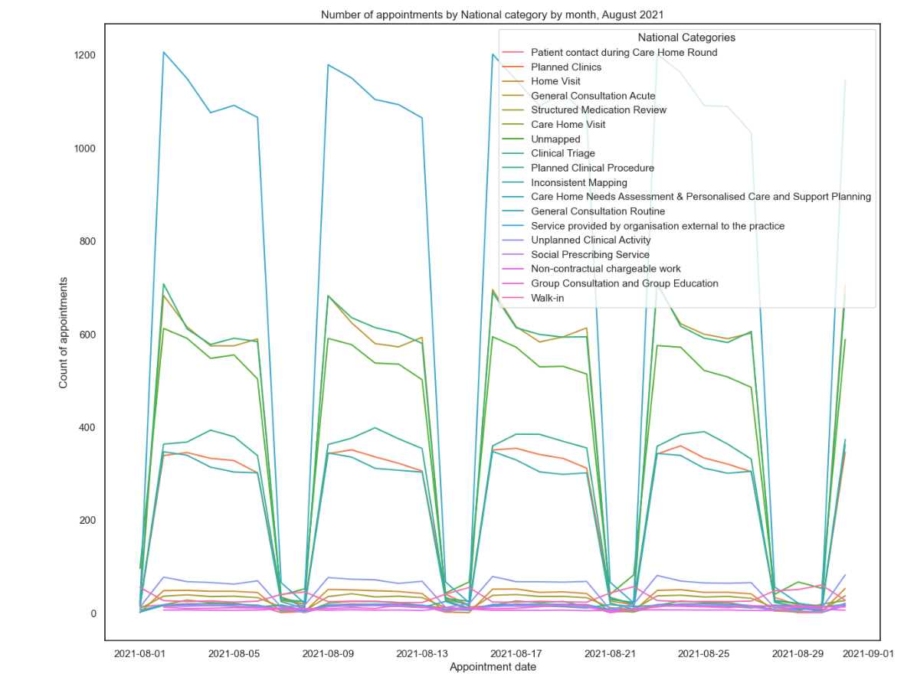
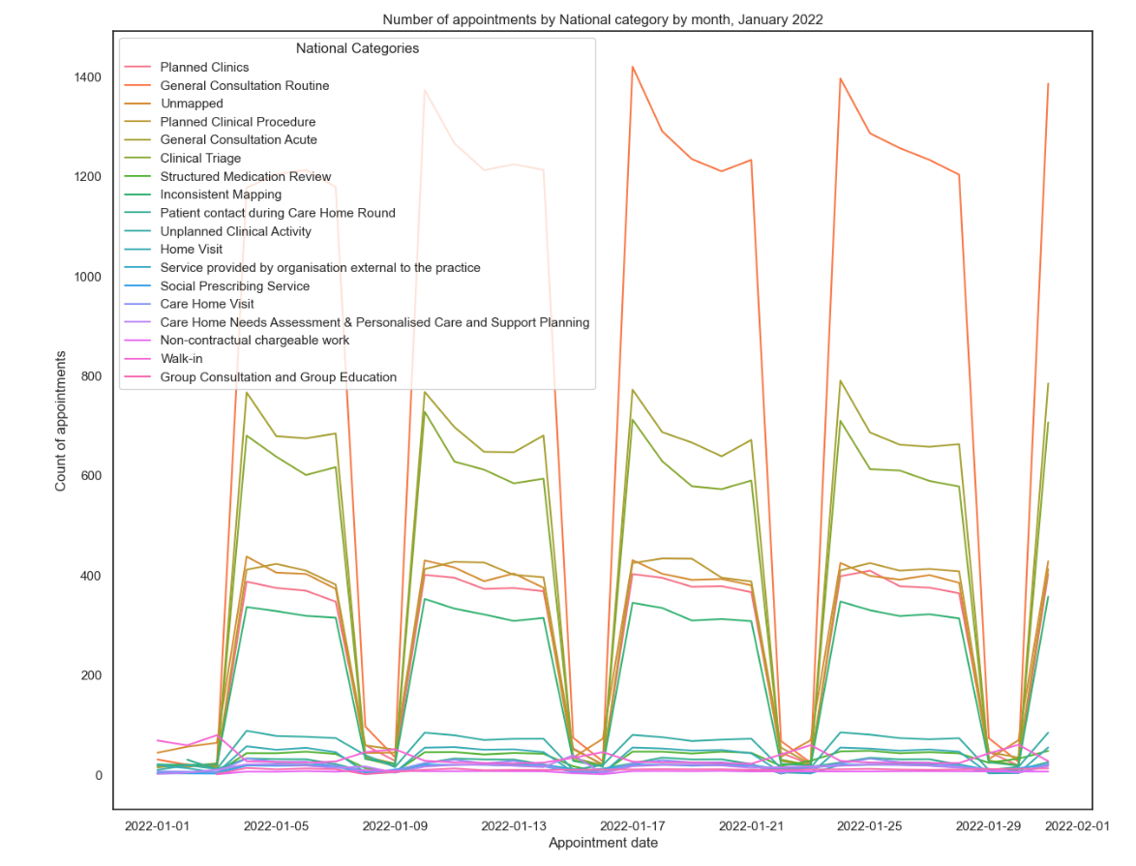
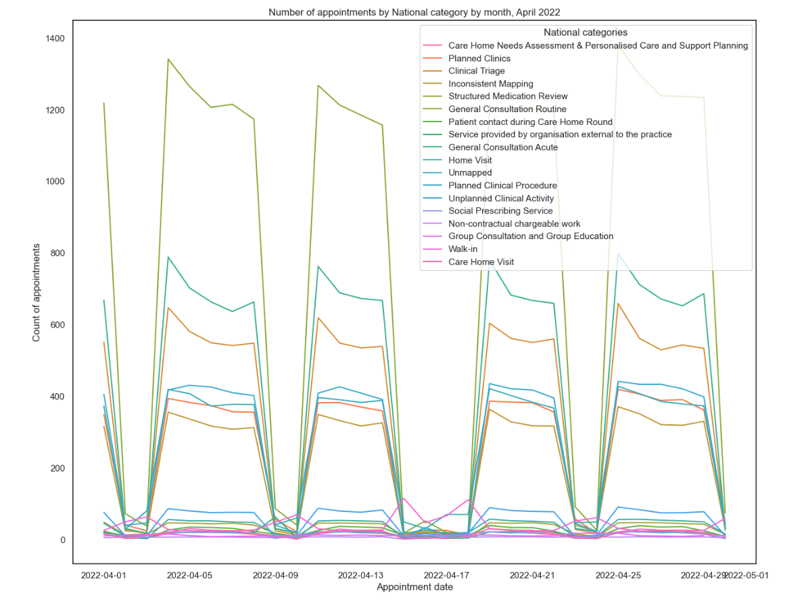
Number of appointments by national category by month
All months showed a drop over weekends, apart from the graph for autumn (October 2021) where there appear to have been appointments in the Planned Clinical Procedures category over the weekends. This could be looked into further.

Slide 8
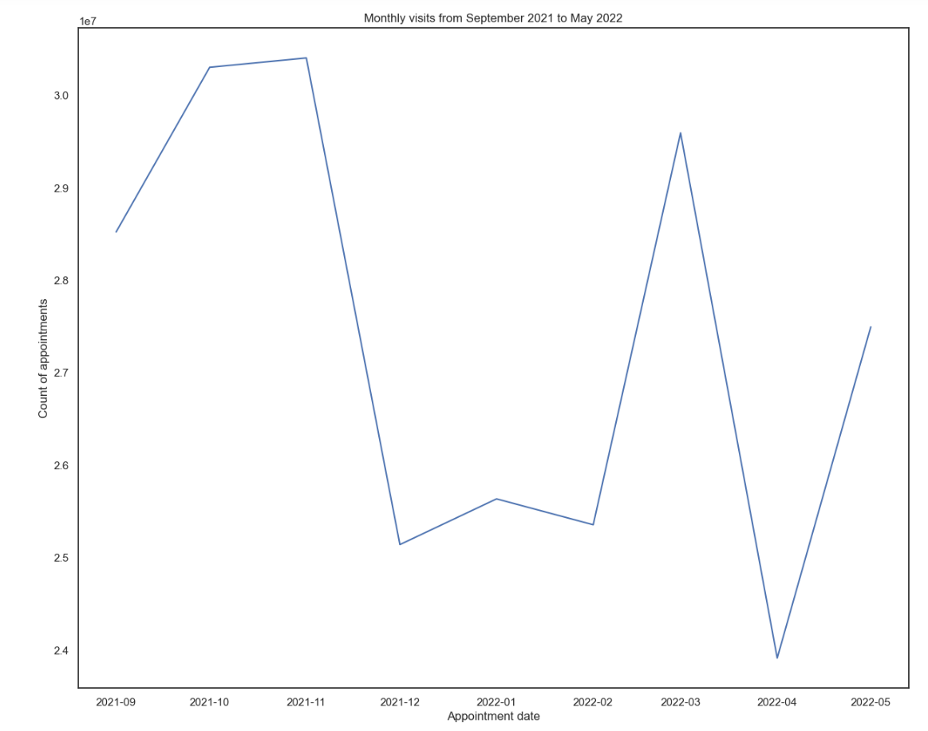
Monthly visits, all categories (Sept 21 – May 22)
A large drop around December could be attributed to the Christmas holidays
Note, the y axis does not start at 0 for better visualisation

Slide 9
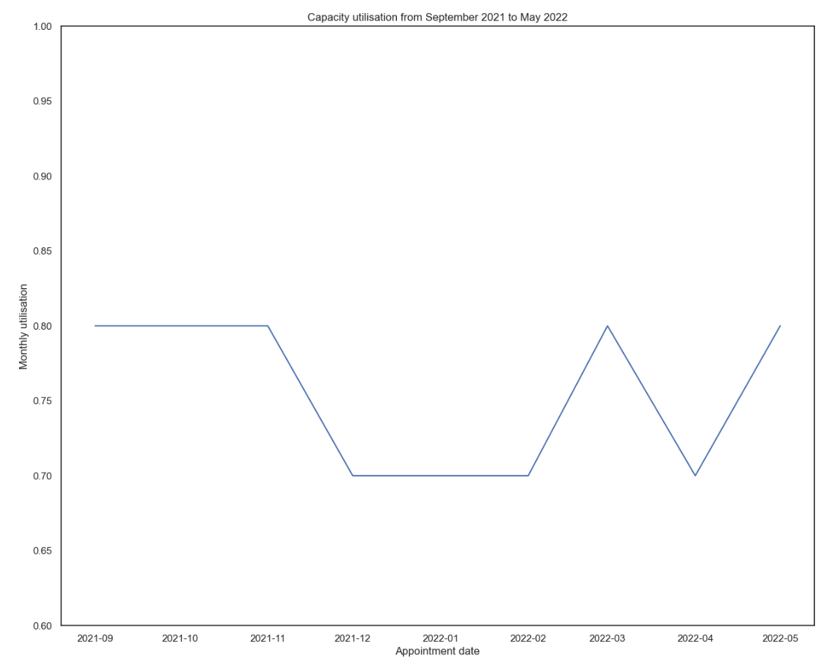
Capacity utilisation, all categories (Sept 21 – May 22)
Capacity utilisation peaks at 80% of total capacity and never exceeds 80%
Note, the y axis does not start at 0 for better visualisation

Slide 10
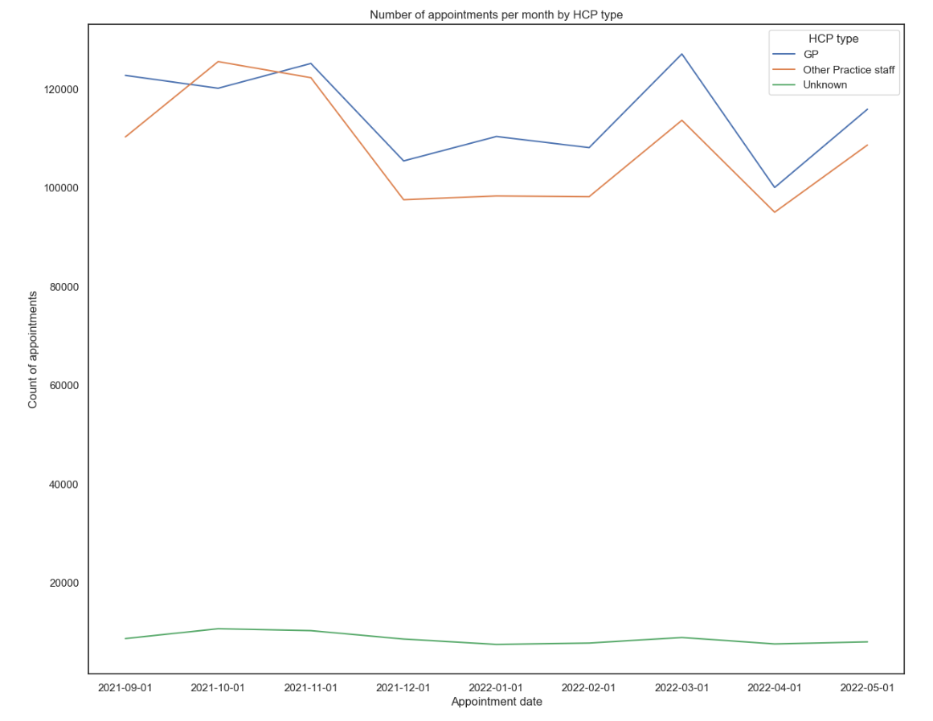
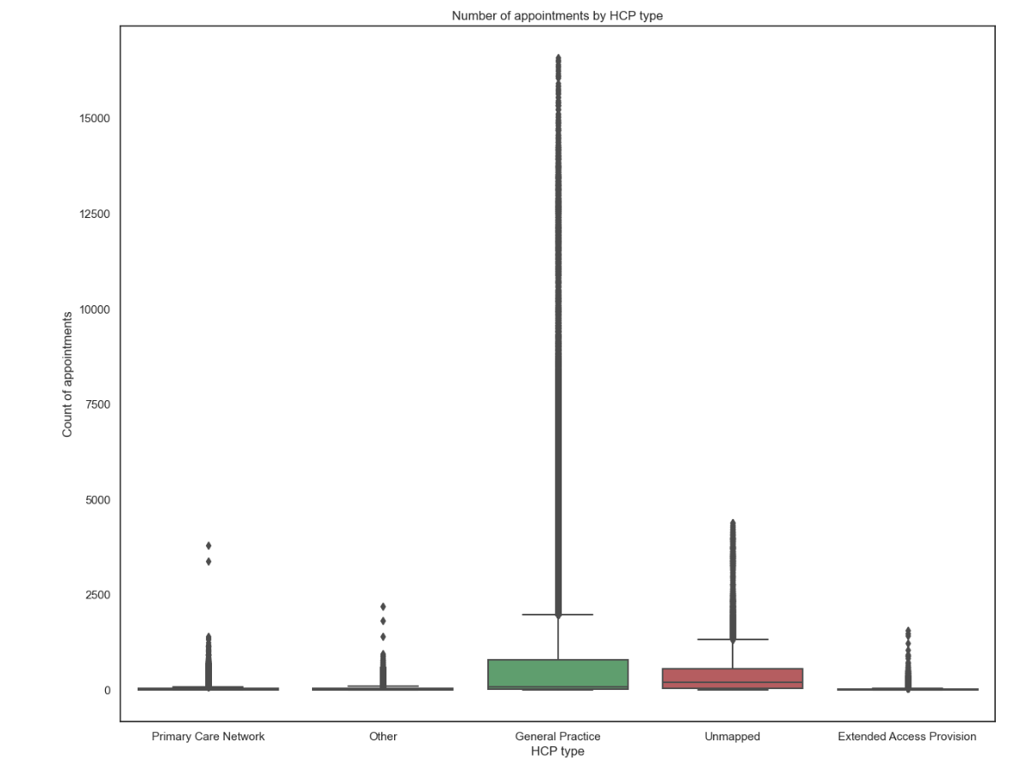
Number of appointments by month, hcp type (sept 21 – may 22)
GP and Other Practice staff follow the same trend with peaks in November and March, and drops in December and April
The December drop could be attribute to the Christmas Bank Holidays
‘Unknown’ appointment types remain relatively steady across the period

Slide 11
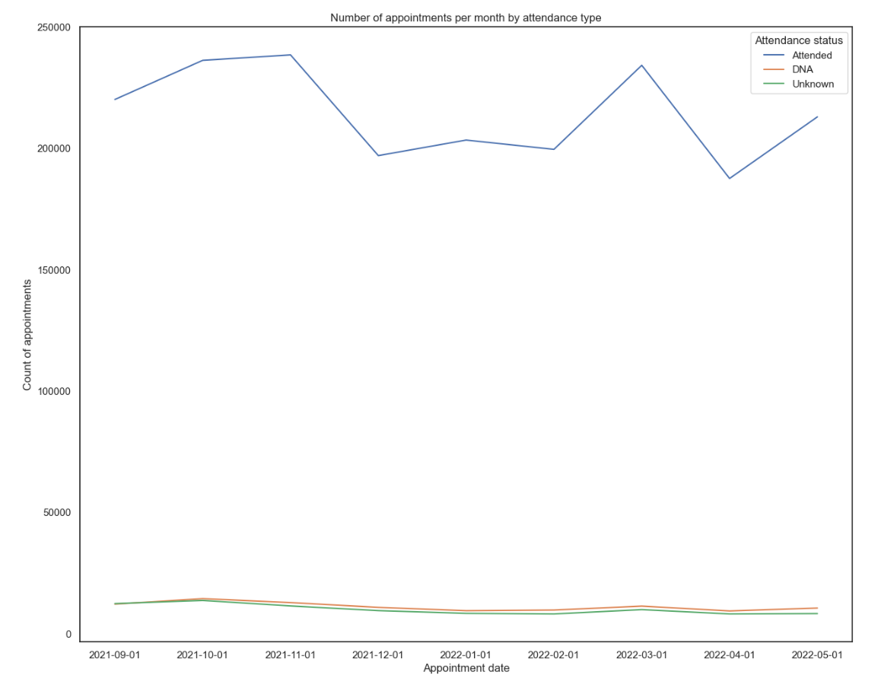
Number of appointments per month by attendance type
The Attended category shows a drop leading up to Christmas and a peak in March
DNA and Unknown follow the same trend as each other at the around the same level of number of appointments

Slide 12
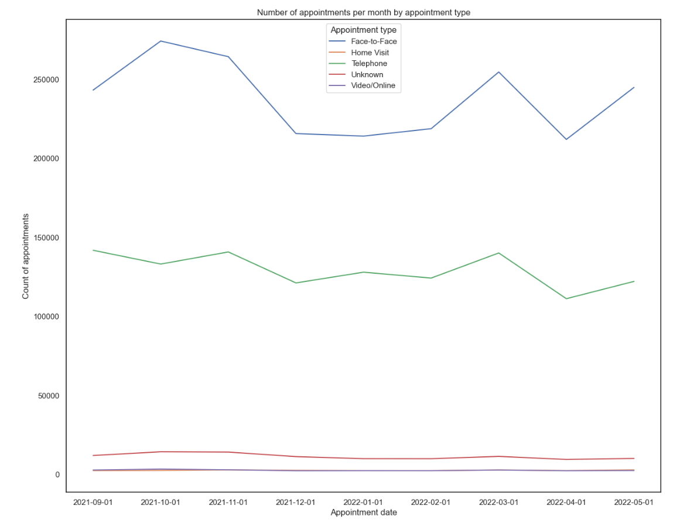
Number of appointments per month by appointment type
The appointment month with the highest number of appointments is Face-to-Face, followed by Telephone
Both of the appointment types with the highest count of appointments follow the same monthly trends

Slide 13
Recommendations

Slide 14
Recommendations
There was adequate staffing over the time period looked at, with capacity reaching a maximum of ~80%
Staffing levels could be revisited and potentially scaled down as the analysis implies there would have been staff present and being paid when they did not need to be, or that staff could be reallocated to other functions or roles where appropriate
Penalties in the form of fines could be introduced for patients missing appointments, but the reason for missing appointments would have to be captured and taken into account in order for this to be fair

